Slide 1
THE NULL FUNCTIONS
NVL, NVL2, NULLIF, and COALESCE

Slide 2
The following functions work with any data type and pertain to using nulls:
NVL (expr1, expr2)
If expr1 is null, return expr2
NVL2 (expr1, expr2, expr3)
If expr1 is null return expr3, else return expr2
NULLIF (expr1, expr2)
If expr1 = expr2, return NULL, else return expr1
COALESCE (expr1, expr2, ..., exprn)
Return the first non-null item. If all items are null, return NULL
Notes:
General Functions
These functions work with any data type and pertain to the use of null values in the expression list.
Note: For more information about the hundreds of functions available, see the section on Functions in Oracle Database SQL Language Reference 11g, Release 1 (11.1).

Slide 3
NVL Function
Converts a null value to an actual value:
Data types that can be used are date, character, and number.
Data types of the 2 parameters must match:
NVL(commission_pct,0)
NVL(hire_date,'01-JAN-97')
NVL(job_id,'No Job Yet')
Both numbers
Both dates
Both char/varchar
Notes:
NVL Function
To convert a null value to an actual value, use the NVL function.
Syntax
NVL (expr1, expr2)
In the syntax:
expr1 is the source value or expression that may contain a null
expr2 is the target value for converting the null
You can use the NVL function to convert any data type, but the return value is always the same as the data type of expr1.
NVL Conversions for Various Data Types

Slide 4
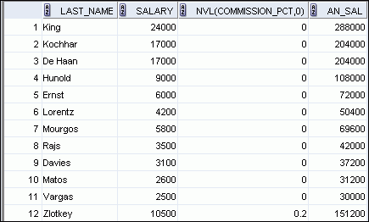
Using the NVL Function
1
SELECT last_name, salary, NVL(commission_pct, 0),
(salary*12) + (salary*12*NVL(commission_pct, 0)) AN_SAL
FROM employees;
2
…
1
2
Notes:
Using the NVL Function
To calculate the annual compensation of all employees, you need to multiply the monthly salary by 12 and then add the commission percentage to the result:
SELECT last_name, salary, commission_pct,
(salary*12) + (salary*12*commission_pct) AN_SAL FROM employees;
Notice that the annual compensation is calculated for only those employees who earn a commission. If any column value in an expression is null, the result is null. To calculate values for all employees, you must convert the null value to a number before applying the arithmetic operator. In the example in the slide, the NVL function is used to convert null values to zero.
…
…

Slide 5
Using the NVL2 Function
Syntax
NVL2(expr1, expr2, expr3)
Meaning:
expr1 is the source value or expression that may contain a null
expr2 is the value that is returned if expr1 is not null
expr3 is the value that is returned if expr1 is null
Note: The argument expr1 can have any data type. The arguments expr2 and expr3 can have any data types except LONG.
SELECT NVL2(commission_pct, 'COMMISSION', 'SALARY ONLY')
FROM employees;
Notes:
Using the NVL2 Function
The NVL2 function examines the first expression. If the first expression is not null, then the NVL2 function returns the second expression. If the first expression is null, then the third expression is returned.
Syntax
NVL2(expr1, expr2, expr3)
In the syntax:
expr1 is the source value or expression that may contain a null
expr2 is the value that is returned if expr1 is not null
expr3 is the value that is returned if expr1 is null
In the example shown in the slide, the COMMISSION_PCT column is examined. If a value is detected, the text literal value of SAL+COMM is returned. If the COMMISSION_PCT column contains a null value, the text literal value of SAL is returned.
Notes: The argument expr1 can have any data type. The arguments expr2 and expr3 can have any data types except LONG.

Slide 6
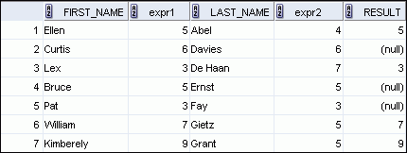
Using the NULLIF Function
1
SELECT first_name, LENGTH(first_name) "expr1",
last_name, LENGTH(last_name) "expr2",
NULLIF(LENGTH(first_name), LENGTH(last_name)) result
FROM employees;
2
3
…
1
2
3
Notes:
Using the NULLIF Function
The NULLIF function compares two expressions. If they are equal, the function returns a null. If they are not equal, the function returns the first expression. However, you cannot specify the literal NULL for the first expression.
Syntax
NULLIF (expr1, expr2)
In the syntax:
NULLIF compares expr1 and expr2. If they are equal, then the function returns null. If they are not, then the function returns expr1. However, you cannot specify the literal NULL for expr1.
In the example shown in the slide, the length of the first name in the EMPLOYEES table is compared to the length of the last name in the EMPLOYEES table. When the lengths of the names are equal, a null value is displayed. When the lengths of the names are not equal, the length of the first name is displayed.
Note: The NULLIF function is logically equivalent to the following CASE expression. The CASE expression is discussed on a subsequent page:
CASE WHEN expr1 = expr 2 THEN NULL ELSE expr1 END

Slide 7
Using the COALESCE Function
The advantage of the COALESCE function over the NVL function is that the COALESCE function can take multiple alternate values.
If the first expression is not null, the COALESCE function returns that expression; otherwise, it does a COALESCE of the remaining expressions.
Notes:
Using the COALESCE Function
The COALESCE function returns the first non-null expression in the list.
Syntax
COALESCE (expr1, expr2, ... exprn)
In the syntax:
expr1 returns this expression if it is not null
expr2 returns this expression if the first expression is null and this expression is not null
exprn returns this expression if the preceding expressions are null
Note that all expressions must be of the same data type.

Slide 8
Syntax COALESCE (expr1, expr2, ... exprn)
Returns expr1 if it is not null
Returns expr2 if expr1 is null and expr2 is not null
returns exprn if the preceding expressions are null
Note that all expressions must be of the same data type.

Slide 9
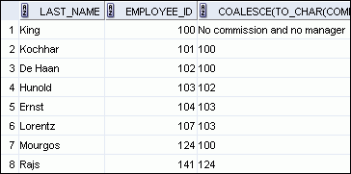
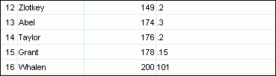
Using the COALESCE Function
SELECT last_name, employee_id,
COALESCE(TO_CHAR(commission_pct),TO_CHAR(manager_id),
'No commission and no manager')
FROM employees;
…
…
Notes:
Using the COALESCE Function (continued)
In the example shown in the slide, if the manager_id value is not null, it is displayed. If the manager_id value is null, then the commission_pct is displayed. If the manager_id and commission_pct values are null, then “No commission and no manager” is displayed. Note, TO_CHAR function is applied so that all expressions are of the same data type.

Slide 10
Notes:
Using the COALESCE Function (continued)
Example:
For the employees who do not get any commission, your organization wants to give a salary increment of $2,000 and for employees who get commission, the query should compute the new salary that is equal to the existing salary added to the commission amount.
SELECT last_name, salary, commission_pct,
COALESCE((salary+(commission_pct*salary)), salary+2000, salary) "New Salary"
FROM employees;
Note: Examine the output. For employees who do not get any commission, the New Salary column shows the salary incremented by $2,000 and for employees who get commission, the New Salary column shows the computed commission amount added to the salary.
…
…

